Slide 1
Introduction to Ensembl REST and EnsemblLite
Daniela Robles, LIIGH-UNAM, Mexico
Gavin Huttley, ANU, Australia
Stefano Giorgetti, EnsEMBL, UK

Slide 2
Overview of the day
11am-11:15am Quick introductions
11:15-11:50am EnsEMBL REST introduction
11:50am-12pm Break
12-12:50pm EnsEMBL REST exercises
12:50-1pm Break
1-1:50pm EnsEMBL REST exercises
1:50-2pm Break
2-2:15pm EnsemblLite: motivation and introduction
2:15-2:50pm Demonstration of EnsemblLite capabilities and Cogent3
2:50-3pm Break
3-4pm Hacking of EnsemblLite code

Slide 3
Quick introductions!
In about 30 seconds, please tell us:
Your name
Where you work
What you’re interested in
What you expect from this mini-course

Slide 4

Ensembl REST introduction: Accessing genome data programatically
Carla Daniela Robles-Espinoza, Ph.D.
Associate Professor, LIIGH-UNAM, Mexico
Based on slides from the Ensembl Project

Slide 5
Course materials
This course:
https://github.com/cogent3/SMBE2024Workshop/tree/main/EnsEMBL_REST_API
EnsEMBL Project:
http://training.ensembl.org/events/
Slides
Jupyter notebooks

Slide 6
What is Ensembl?
Ensembl is an open source genome browser with a large amount of data available to explore and a number of biological annotations:
www.ensembl.org
Genomic assemblies: automated gene annotation
Variation: Small and large-scale sequence variation with phenotype associations
Comparative genomics: Whole genome alignments, gene trees
Regulation: Potential promoters and enhancers, DNA regulation

Slide 7
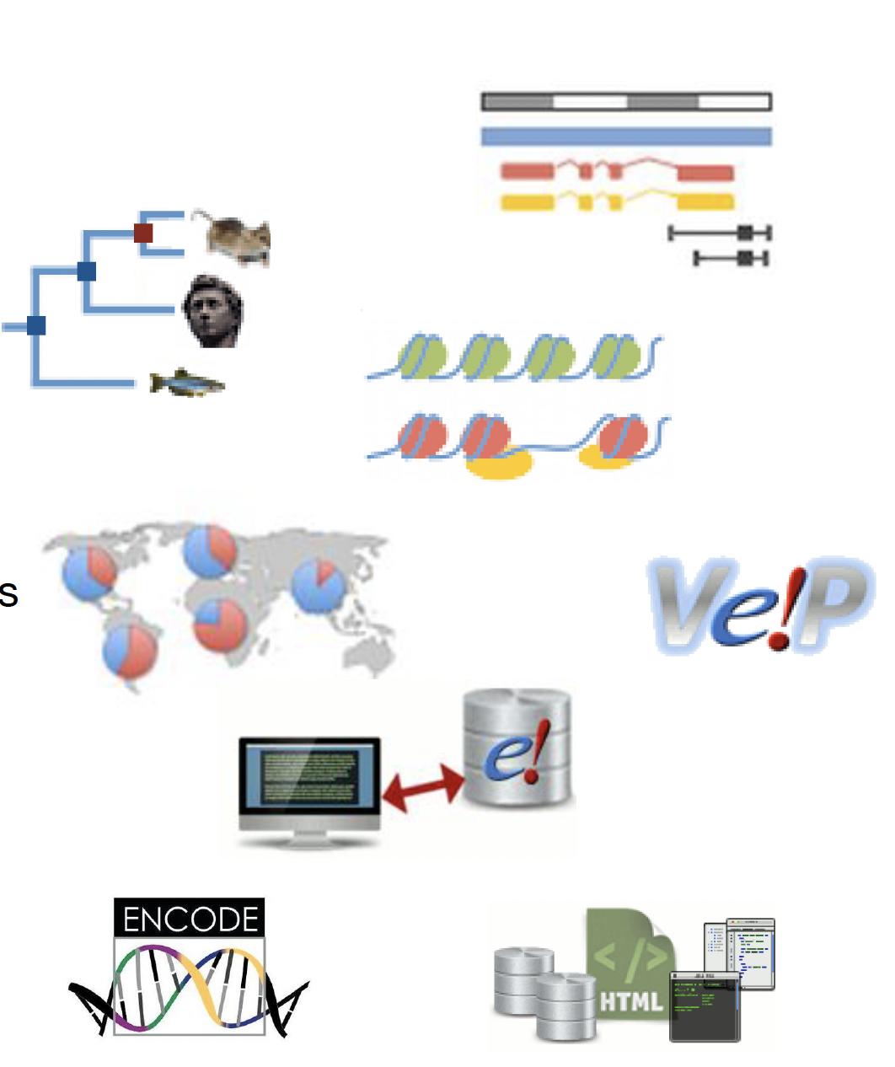
Ensembl Features
Gene builds for >300 species
Gene trees
Regulatory build (ENCODE)
Variation display and VEP
Display of user data
BioMart (data export)
Programmatic access via the APIs
Completely open source

Slide 8
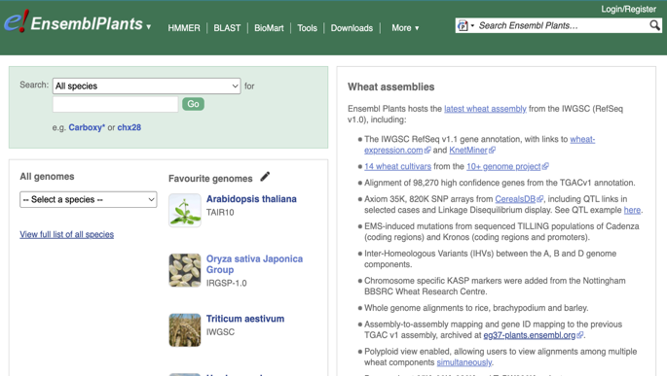
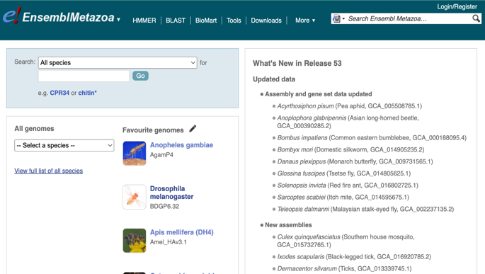

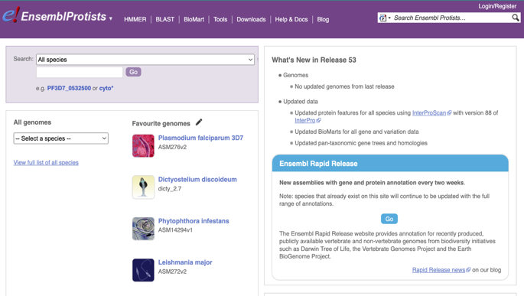
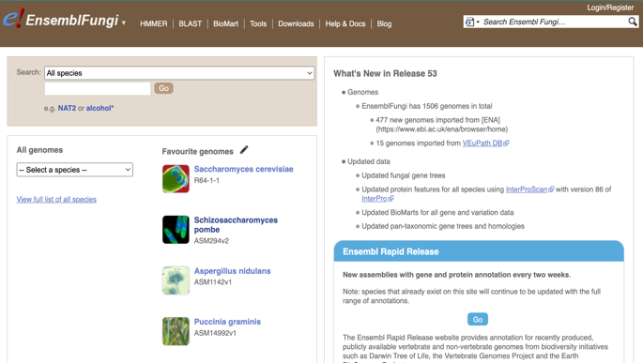
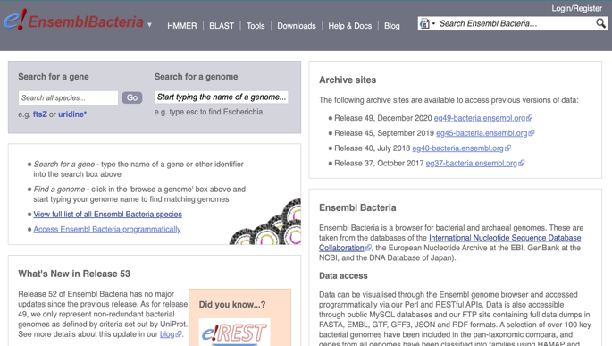
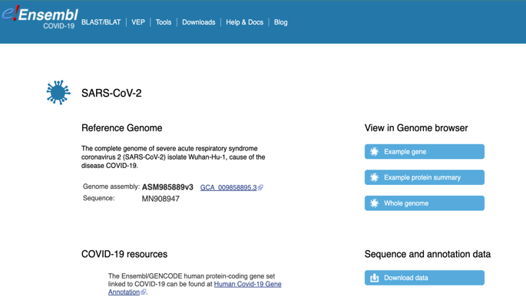
Ensembl sites
EnsemblPlants
EnsemblMetazoa
Ensembl (vertebrates)
Ensembl Genomes (non-vertebrates)
Ensembl Rapid Release
Portals:
Ensembl GRCh37
Ensembl COVID-19
REST
API
EnsemblProtists
EnsemblFungi
REST
API
EnsemblBacteria
EnsemblCOVID-19
Notes:
you cannot access any Ensembl Rapid Release and COVID-19 data via the REST API. The data in Rapid Release will indeed be incorporated but into a new website that we are currently working on: https://beta.ensembl.org/ (this website is still under progress - it is available for users to visit but we do not recommend using it for any analyses). I also want to highlight that accessing Ensembl data via the REST API is not as fast or as customisable as accessing data via the Perl API or our MySQL servers. And finally, you can only access a limited amount of data of what is actually available in Ensembl (users can refer to the REST API documentation for what data are accessible).
Ensembl Rapid Release is a new site designed to make our data available more quickly. Release of data occurs on a two-week cycle, meaning we can make our gene sets available with minimal delay once the annotation is complete. For each species we provide a gene set along with additional features such as protein feature annotation and BLAST functionality.

Slide 9
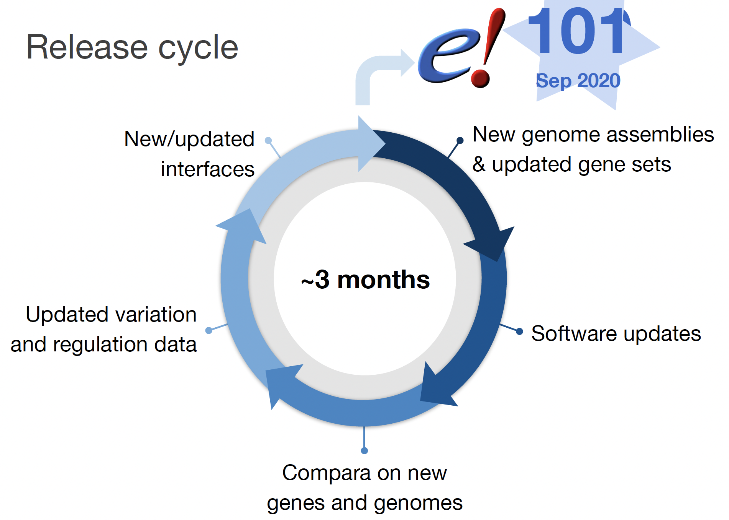
Release cycle
112
May 2024

Slide 10
REST archives
The Ensembl project provides archive services for up to five years, to match the Ensembl website archives.
http://e97.rest.ensembl.org

Slide 11
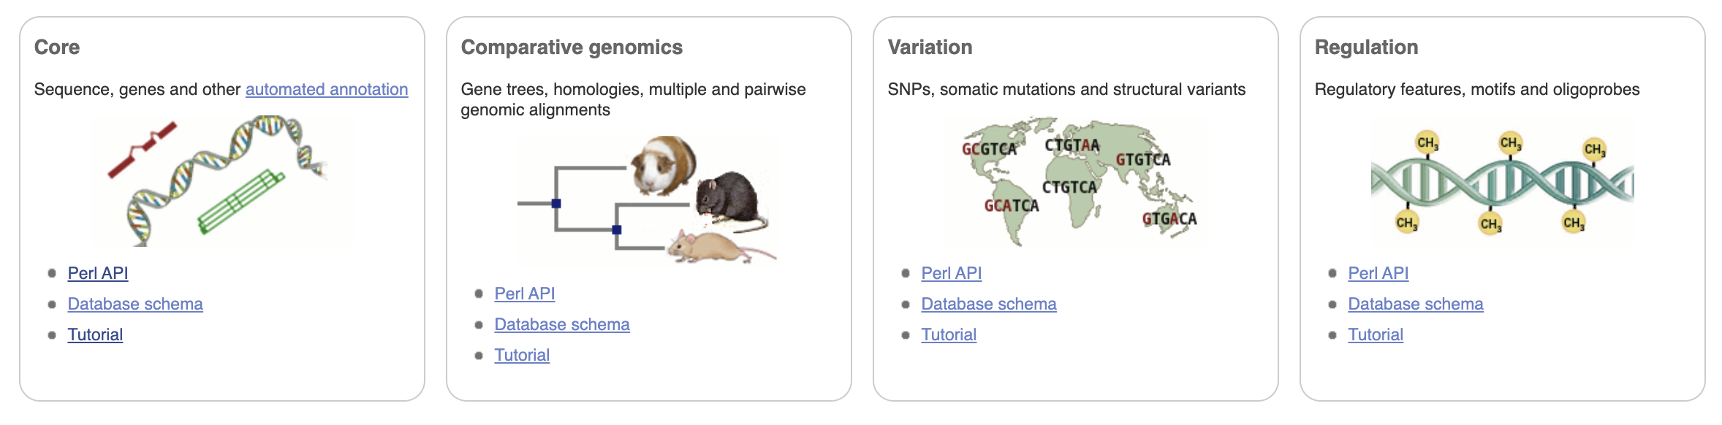
How Ensembl is organised - Schemas

Slide 12
Data objects
These model biological entities, e.g., genes, transcripts, exons, etc.
A data object represents a piece of data that is (or can be) stored in the database.
Gene
Exon
Exon
Transcript

Slide 13
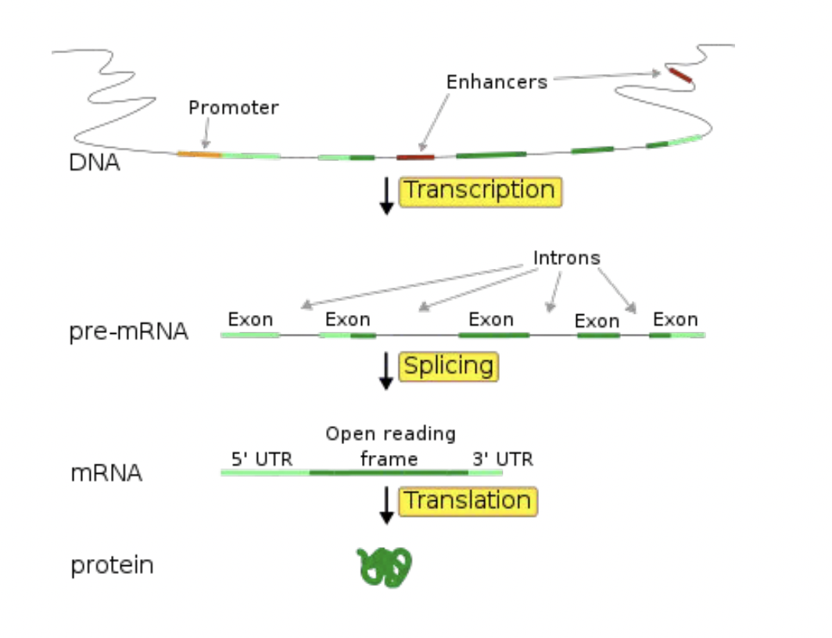
Ensembl data model

Slide 14
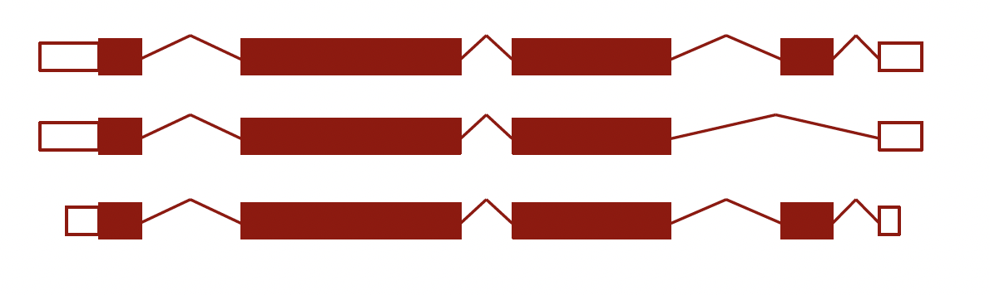
Ensembl data model
Primary Feature types are Genes, Transcripts, and Exons
A Gene is a set of alternatively spliced Transcripts
A Transcript is a set of Exons

Slide 15
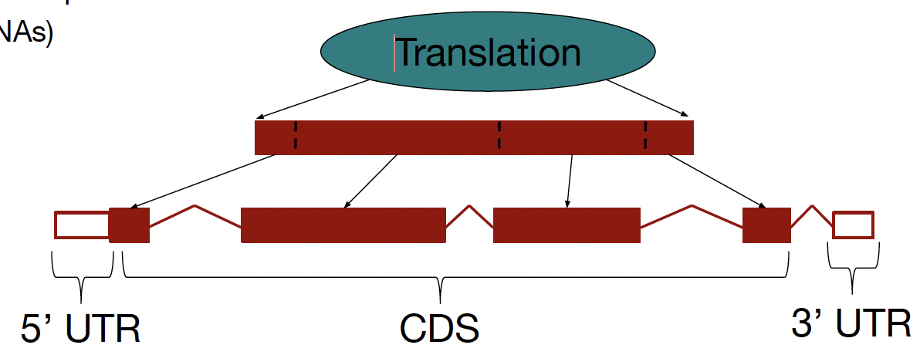
Ensembl data model
Translations are not Features
Peptides are not stored in the database, they are computed on the fly using Transcript objects
Not all transcripts have a translation (e.g., ncRNAs)

Slide 16
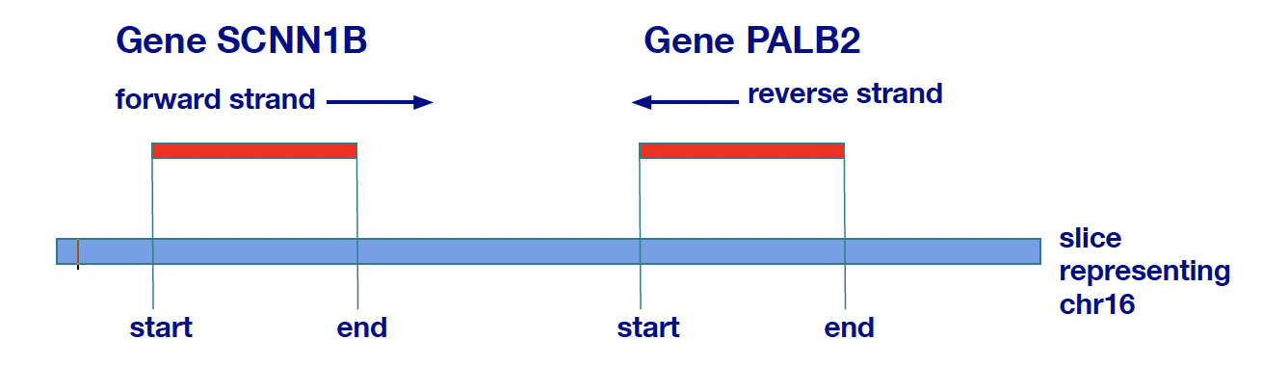
Features
Features have a defined location on the genome
Start and end are always plotted on the forward strand. Start < end
Genes and exons are examples of Features

Slide 17
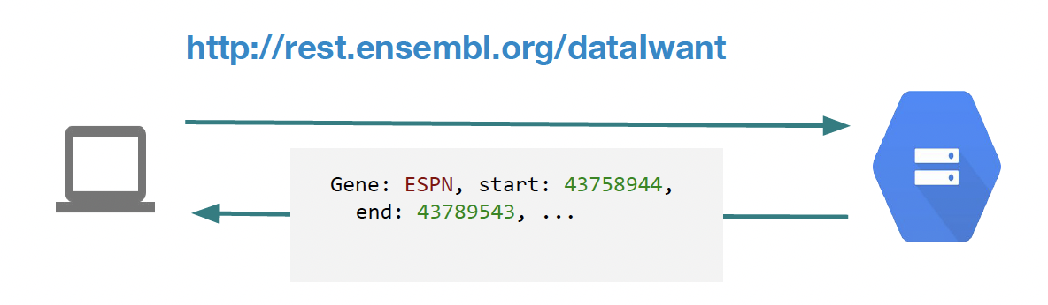
What is a REST API?
Representational State Transfer. It describes how one system can communicate state with another.
Typically over HTTP(s), providing a machine readable, language agnostic method to access remote data or services.

Slide 18
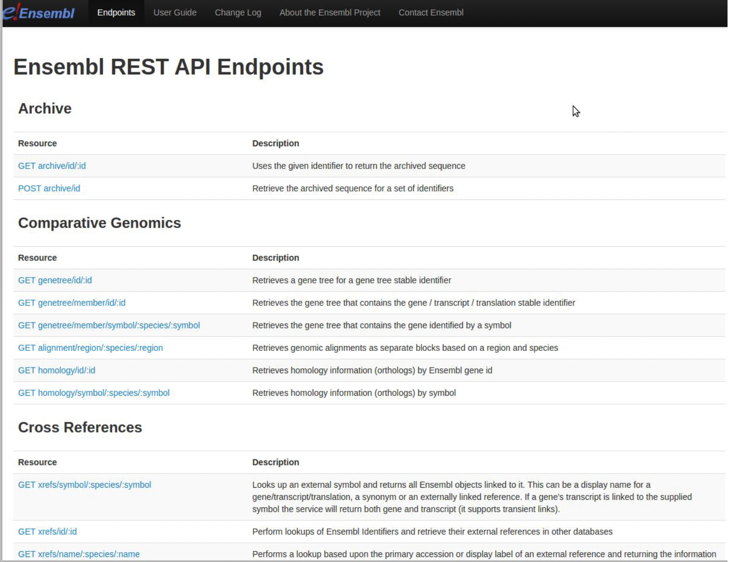
Ensembl REST
Language agnostic access to Ensembl datasets
Only a fraction of the functionality of the Perl API is exposed
http://rest.ensembl.org

Slide 19
What is an endpoint?
An endpoint is a particular output that you can get given a particular input.
It is a function that interacts with the Ensembl database.
Notes:
In REST, the resource typically refers to some object or set of objects that are exposed at an API endpoint.

Slide 20
Endpoint documentation
Full documentation of all the endpoints is found at:
http://rest.ensembl.org
The documentation lists:
All the endpoints grouped by function
The required parameters for each endpoint
Optional parameters
Example code for using the endpoints
Notes:
In REST, the resource typically refers to some object or set of objects that are exposed at an API endpoint.

Slide 21
Functional groupings
Archive
Comparative genomics
Cross references
Information
Lookup
Mapping
Ontology and Taxonomy
Sequence variation
…
Notes:
In REST, the resource typically refers to some object or set of objects that are exposed at an API endpoint.

Slide 22
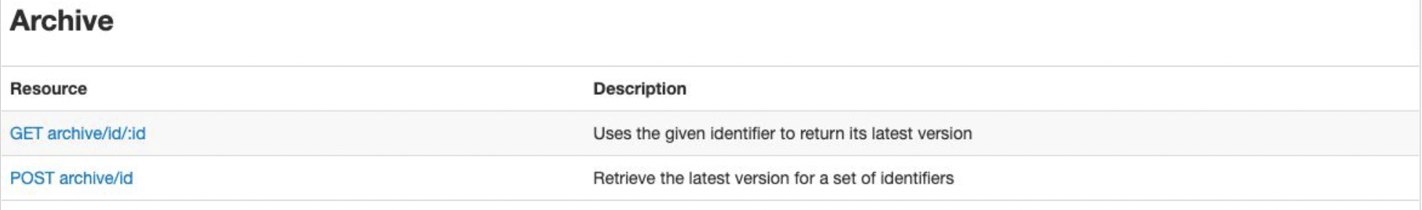
Archive
Fetch latest versions of archive Ensembl IDs
Notes:
In REST, the resource typically refers to some object or set of objects that are exposed at an API endpoint.

Slide 23
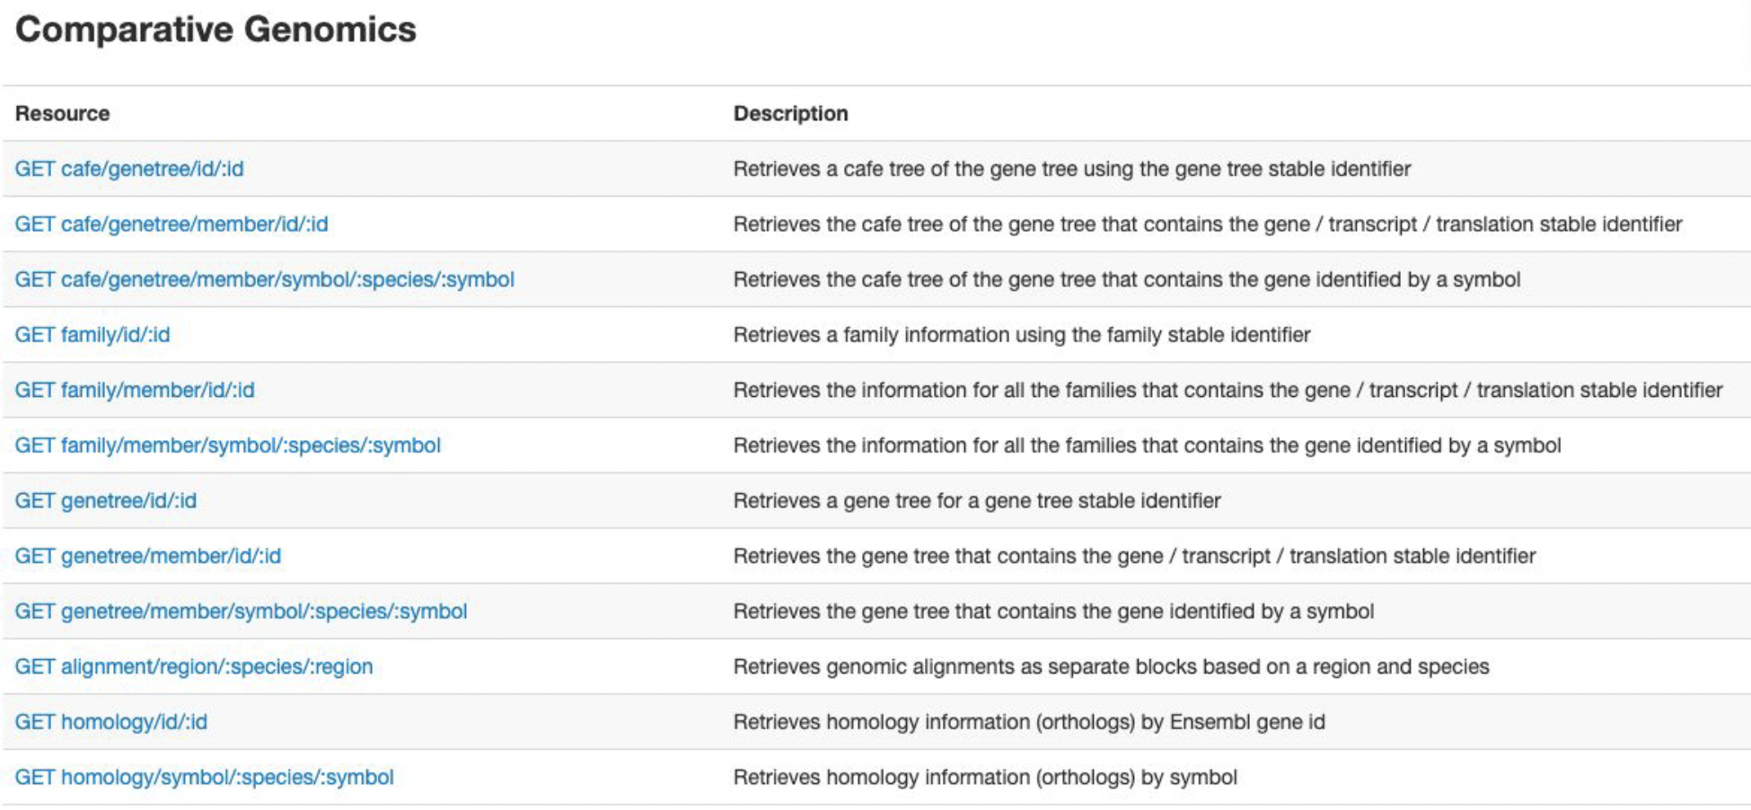
Comparative genomics
Gene trees, homologues, and alignments
Notes:
The Compara pipelines use two main species trees.
The NCBI taxonomy (i.e. topology only) in:
the Protein-trees pipeline
the ncRNA-trees pipeline, where the three sub-trees Eutheria, Sauria, and Clupeocephala are flattened
the CAFE pipelines (Gene Gain/Loss trees), with branch lengths coming from the TimeTree database
A tree with branch-lengths computed in-house (available for download here) in:the Multiple-alignment pipelines
the Constrained Elements / Conservation Scores pipelines

Slide 24
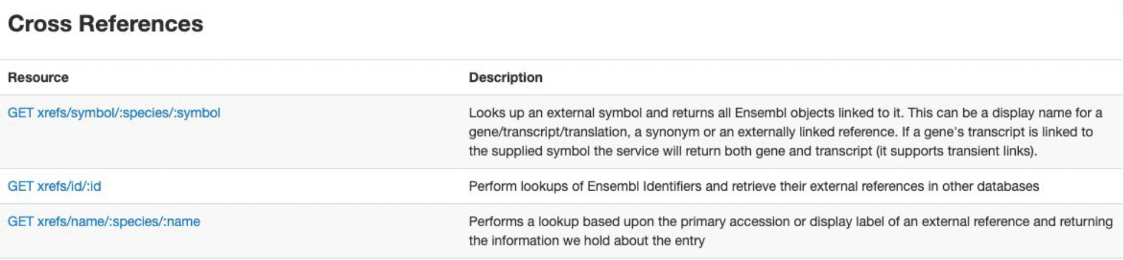
Cross references
Look up other IDs in Ensembl and find other IDs attached to Ensembl objects
Notes:
In REST, the resource typically refers to some object or set of objects that are exposed at an API endpoint.

Slide 25
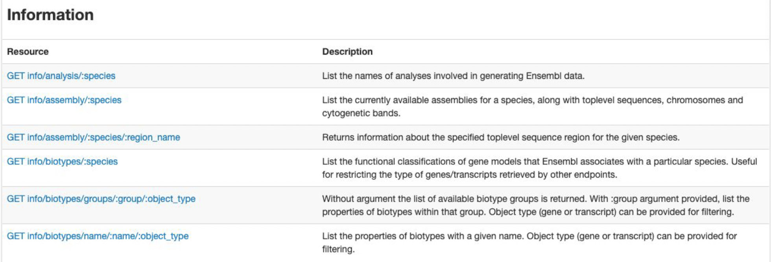
Information
Get current release information and data available
Notes:
In REST, the resource typically refers to some object or set of objects that are exposed at an API endpoint.

Slide 26
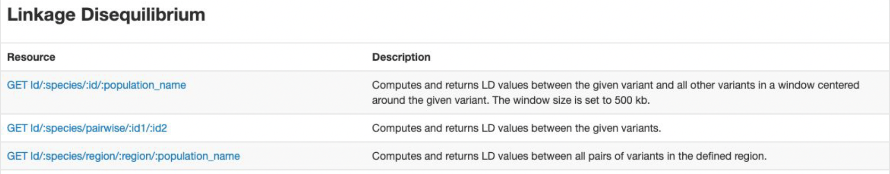
Linkage disequilibrium
Find variants in LD across a locus or to a known variant
Notes:
In REST, the resource typically refers to some object or set of objects that are exposed at an API endpoint.

Slide 27
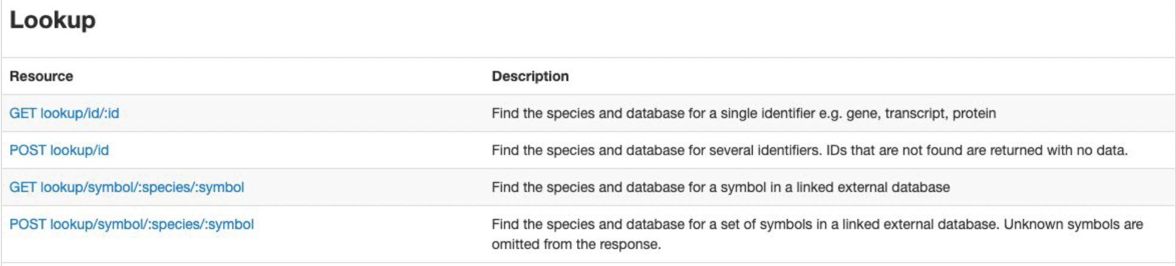
Lookup
Find Ensembl objects in the database
Notes:
In REST, the resource typically refers to some object or set of objects that are exposed at an API endpoint.

Slide 28
Mapping
Map between coordinates
Notes:
In REST, the resource typically refers to some object or set of objects that are exposed at an API endpoint.

Slide 29
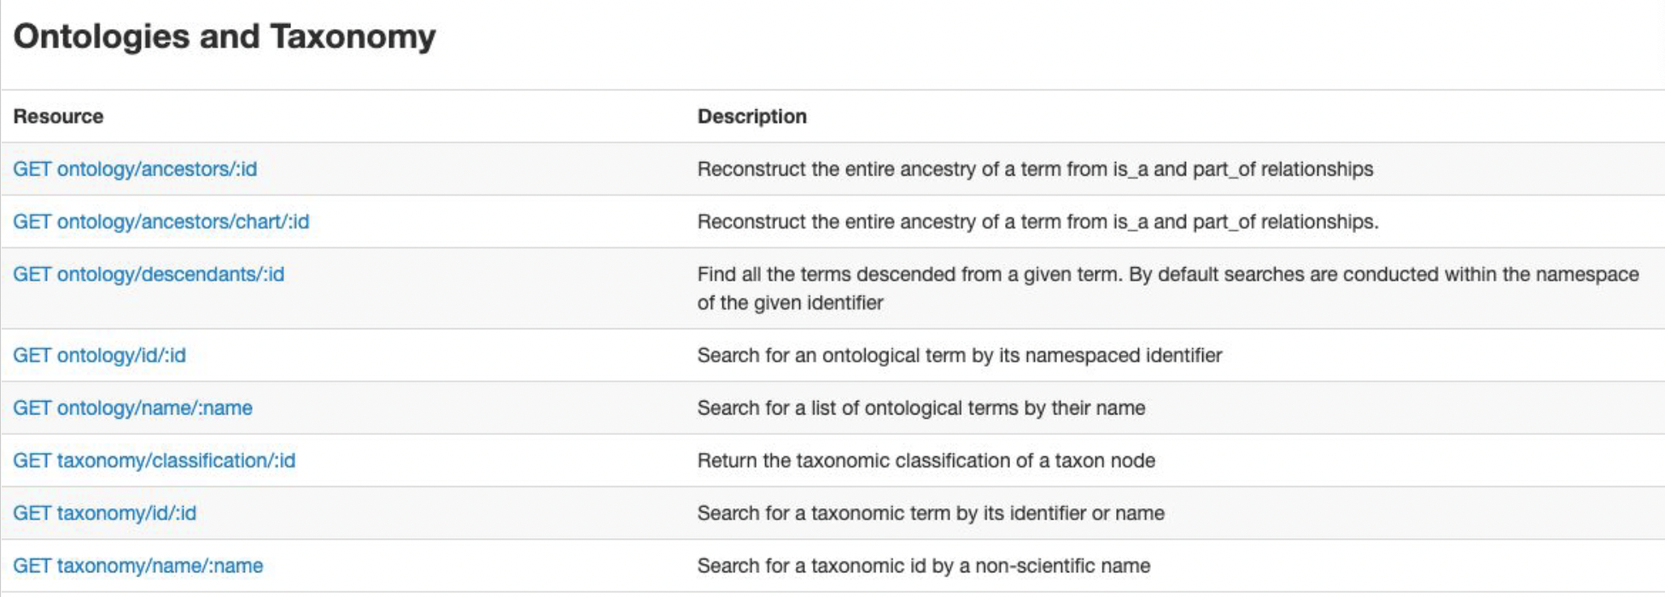
Ontologies and Taxonomy
Map hierarchical relationships
Notes:
In REST, the resource typically refers to some object or set of objects that are exposed at an API endpoint.

Slide 30
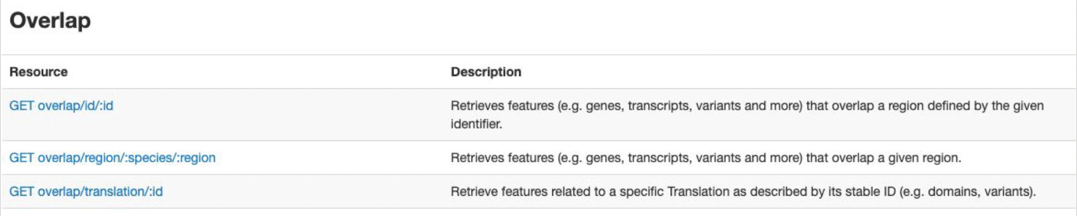
Overlap
Find features that overlaps regions or other features, e.g.,
Genes in a region
Variants in a gene or protein
Domains in a protein
Notes:
In REST, the resource typically refers to some object or set of objects that are exposed at an API endpoint.

Slide 31
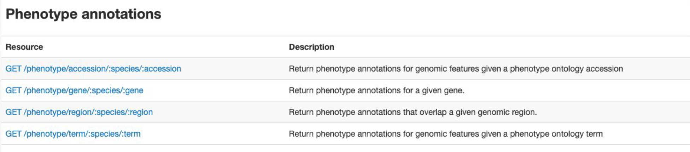
Phenotype associations
Get genes/variants linked to phenotypes
Get phenotypes linked to genes
Notes:
In REST, the resource typically refers to some object or set of objects that are exposed at an API endpoint.

Slide 32
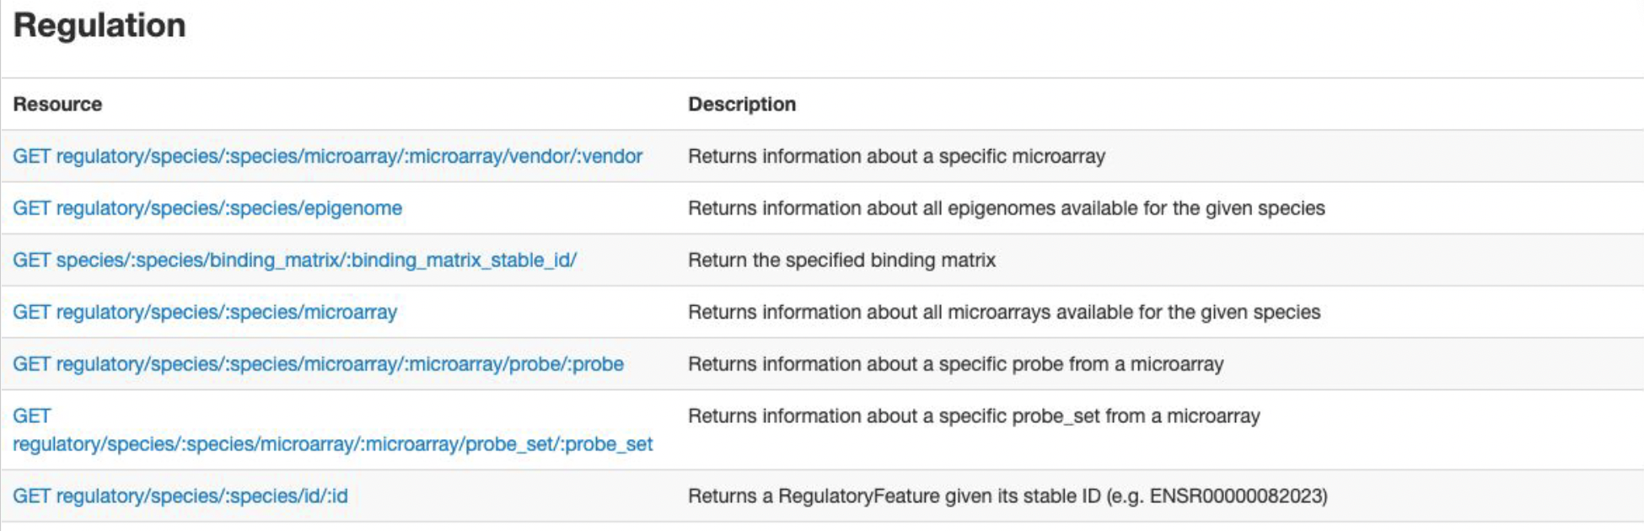
Regulation
Find details of microarrays
Find details of epigenomes and regulatory features
Notes:
In REST, the resource typically refers to some object or set of objects that are exposed at an API endpoint.

Slide 33
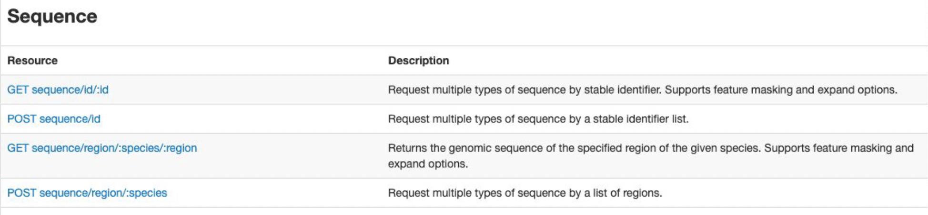
Sequences
Fetch nucleotide and amino acid sequences
Notes:
In REST, the resource typically refers to some object or set of objects that are exposed at an API endpoint.

Slide 34
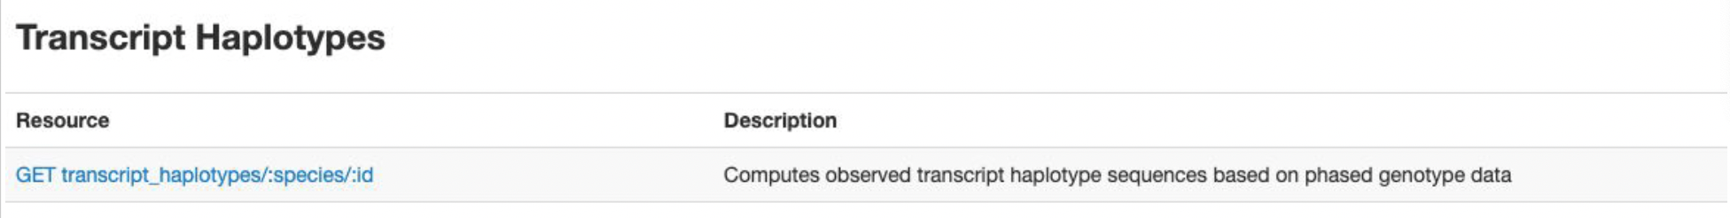
Transcript haplotypes
Get haplotypes from real individuals
Notes:
In REST, the resource typically refers to some object or set of objects that are exposed at an API endpoint.

Slide 35
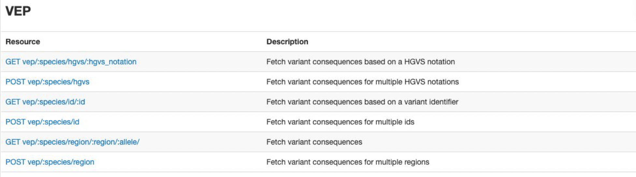
VEP
Get variant consequences on genes and transcripts
Notes:
In REST, the resource typically refers to some object or set of objects that are exposed at an API endpoint.

Slide 36
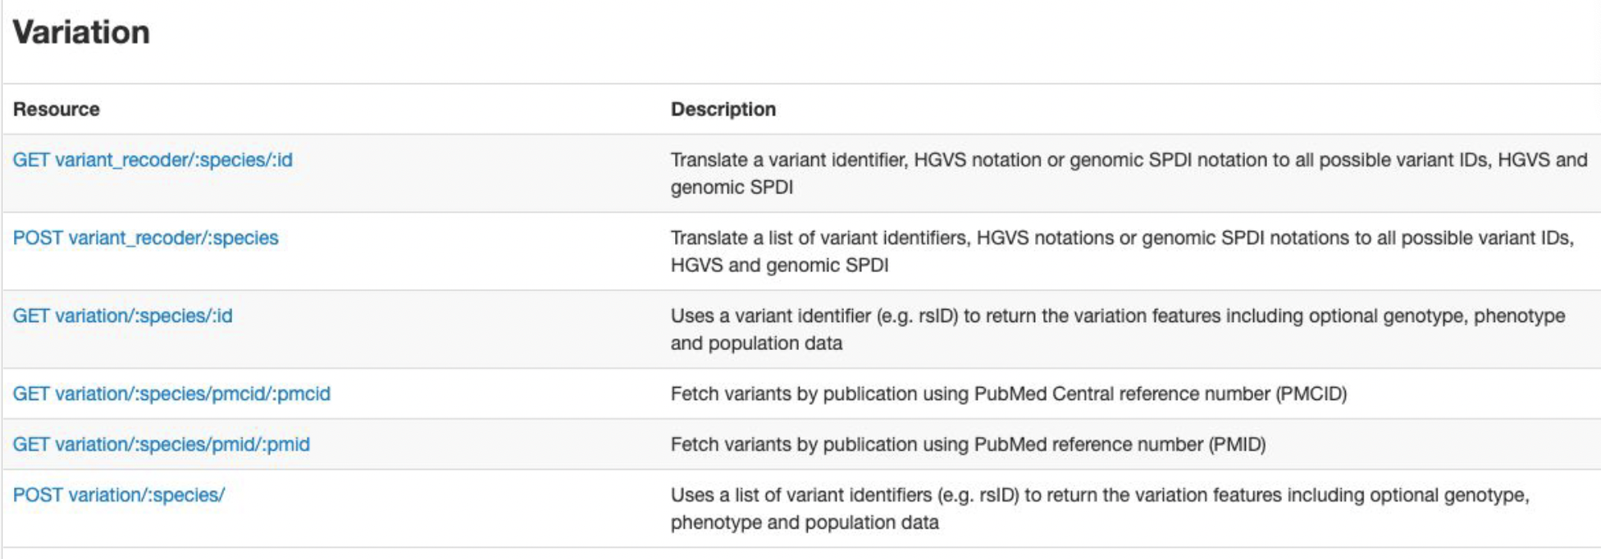
Variation
Get information about Ensembl variants
Notes:
In REST, the resource typically refers to some object or set of objects that are exposed at an API endpoint.

Slide 37
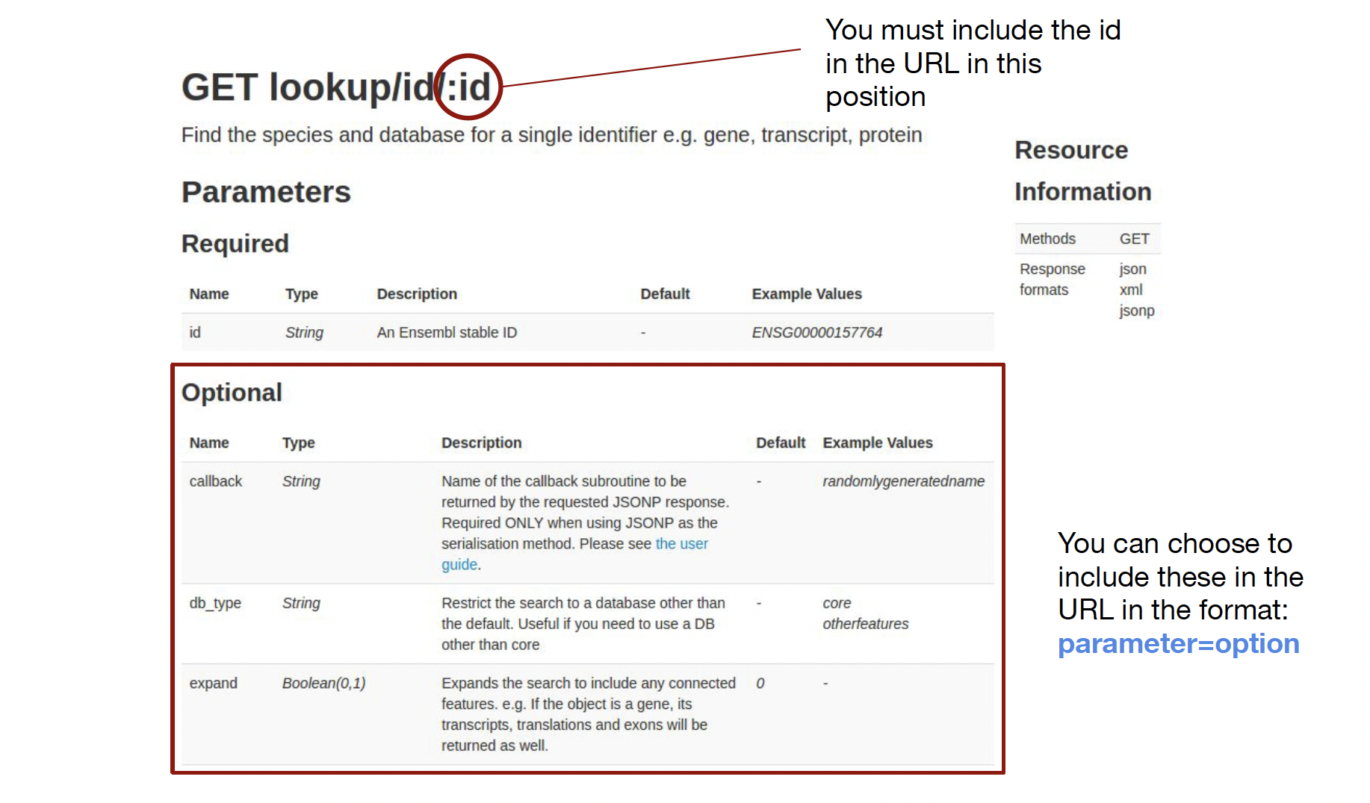
Endpoint Documentation
Notes:
In REST, the resource typically refers to some object or set of objects that are exposed at an API endpoint.

Slide 38
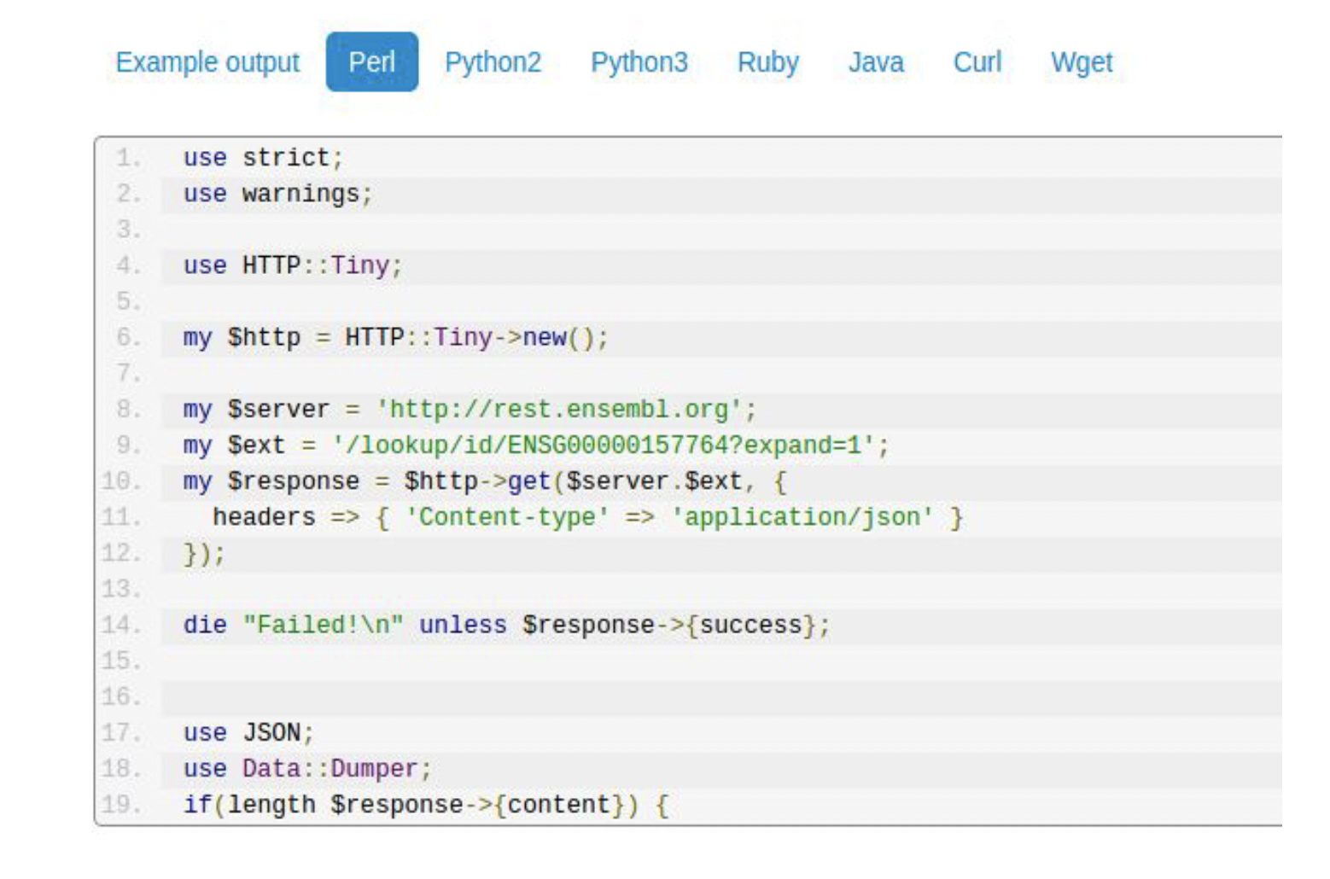
Sample code
Notes:
In REST, the resource typically refers to some object or set of objects that are exposed at an API endpoint.

Slide 39
Making a REST call in the browser
The easiest way to make REST calls is to put URLs into the browser
This can be used as a quick look-up
This can help you to test the URLs in your scripts to see:
If they work
If you’ve included the correct parameters
What the output looks like
Notes:
In REST, the resource typically refers to some object or set of objects that are exposed at an API endpoint.

Slide 40
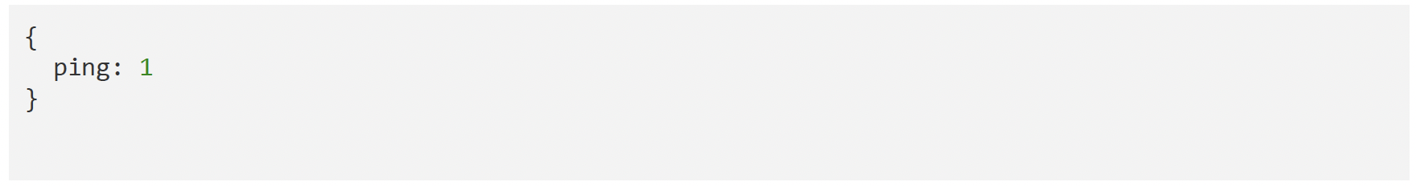
Pinging the database
Ping confirms that you have a connection to the database
http://rest.ensembl.org/info/ping?content-type=application/json
Notes:
In REST, the resource typically refers to some object or set of objects that are exposed at an API endpoint.

Slide 41
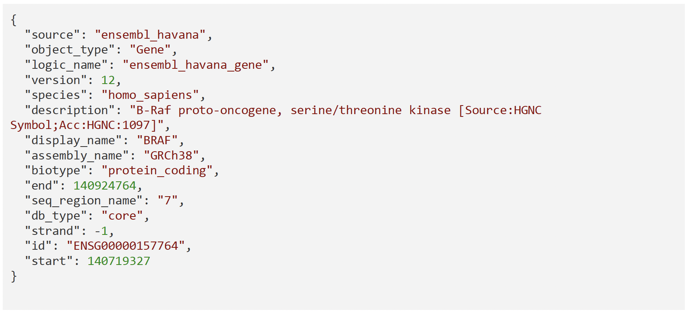
Requesting a gene by ID
http://rest.ensembl.org/lookup/id/ENSG00000157764?content-type=application/json
Notes:
In REST, the resource typically refers to some object or set of objects that are exposed at an API endpoint.

Slide 42
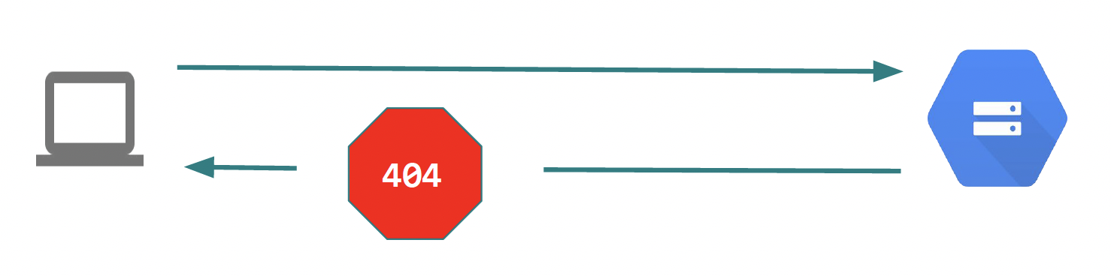
HTTP Status Codes
The server uses HTTP status codes to signal the request outcome
http://rest.ensembl.org/thisdoesntexist
Notes:
In REST, the resource typically refers to some object or set of objects that are exposed at an API endpoint.

Slide 43
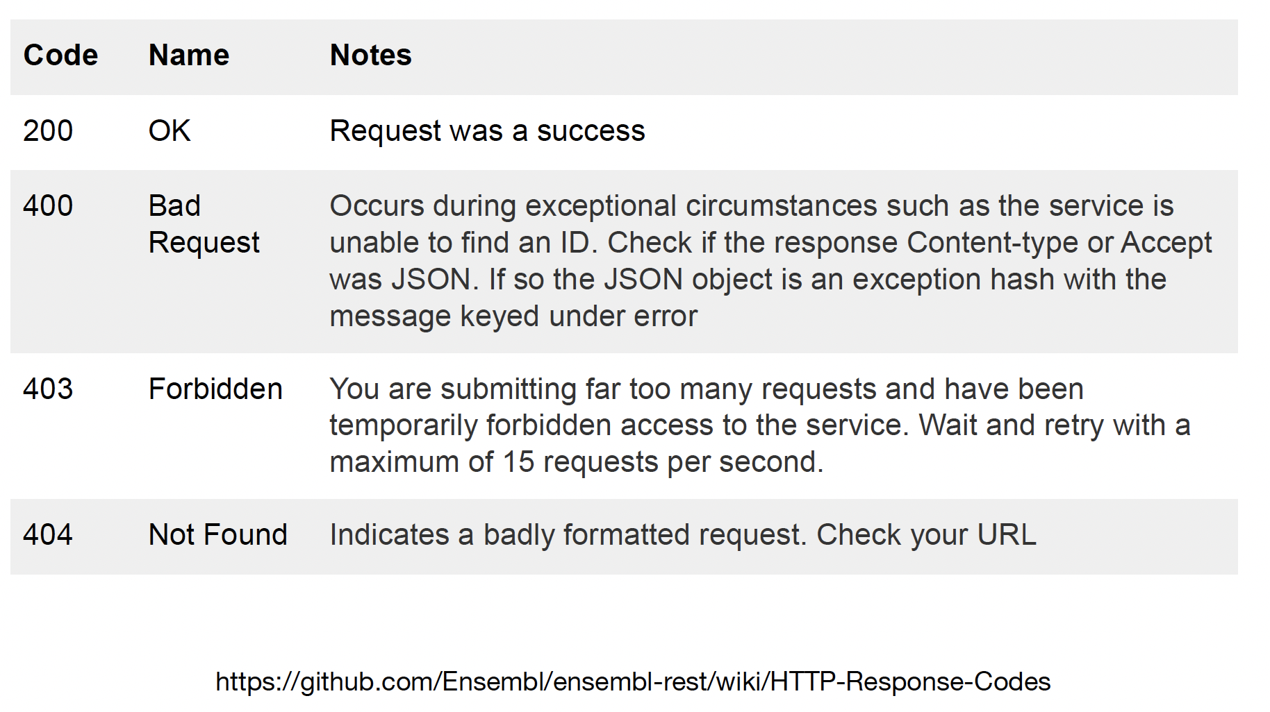
HTTP Status Codes
Notes:
In REST, the resource typically refers to some object or set of objects that are exposed at an API endpoint.

Slide 44
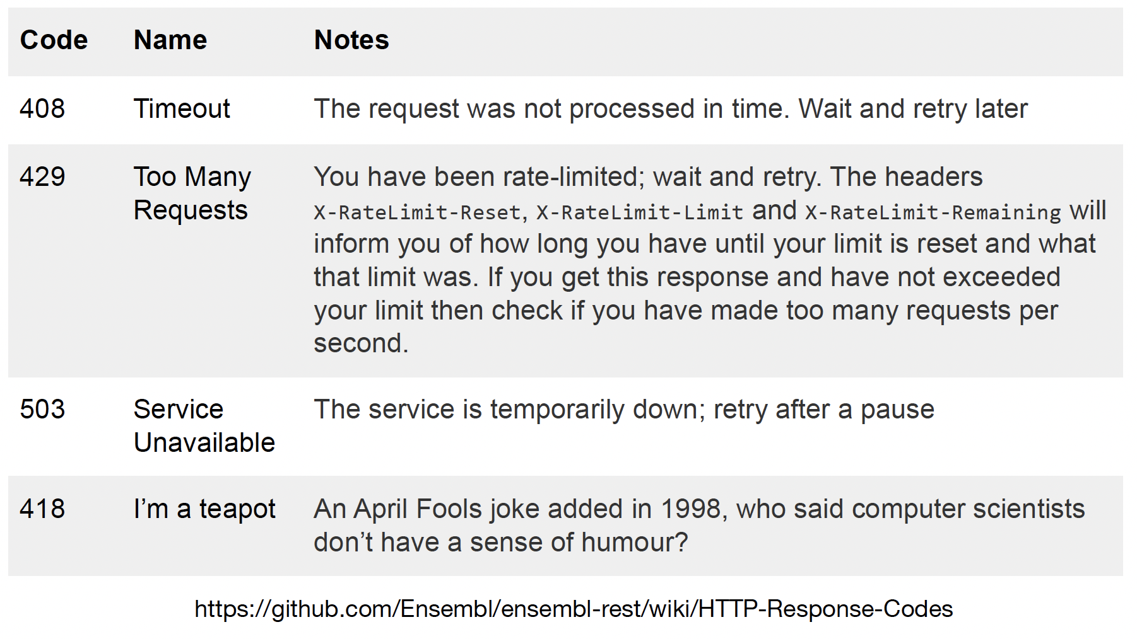
HTTP Status Codes (cont.)
Notes:
In REST, the resource typically refers to some object or set of objects that are exposed at an API endpoint.

Slide 45
Scripting around REST API calls
Scripting around calls allows you to:
Extract specific bits of data from your REST call
Output in your preferred format
Link together calls for more complicated queries
Integrate your queries into a larger pipeline
Notes:
In REST, the resource typically refers to some object or set of objects that are exposed at an API endpoint.

Slide 46
Language agnostic access
REST APIs are designed to be accessed using any programming language
Calls can be made and decoded within any script
The Ensembl project has examples in Python, Perl and R
Notes:
In REST, the resource typically refers to some object or set of objects that are exposed at an API endpoint.

Slide 47
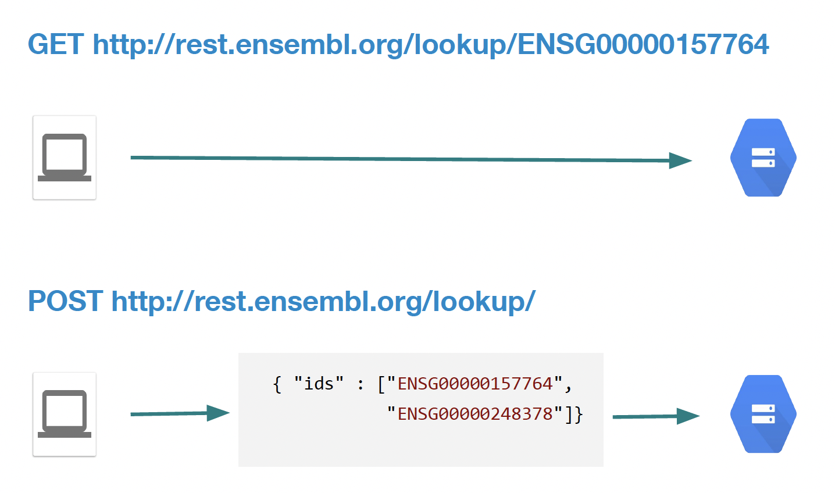
HTTP Methods – GET vs POST
Notes:
In REST, the resource typically refers to some object or set of objects that are exposed at an API endpoint.

Slide 48
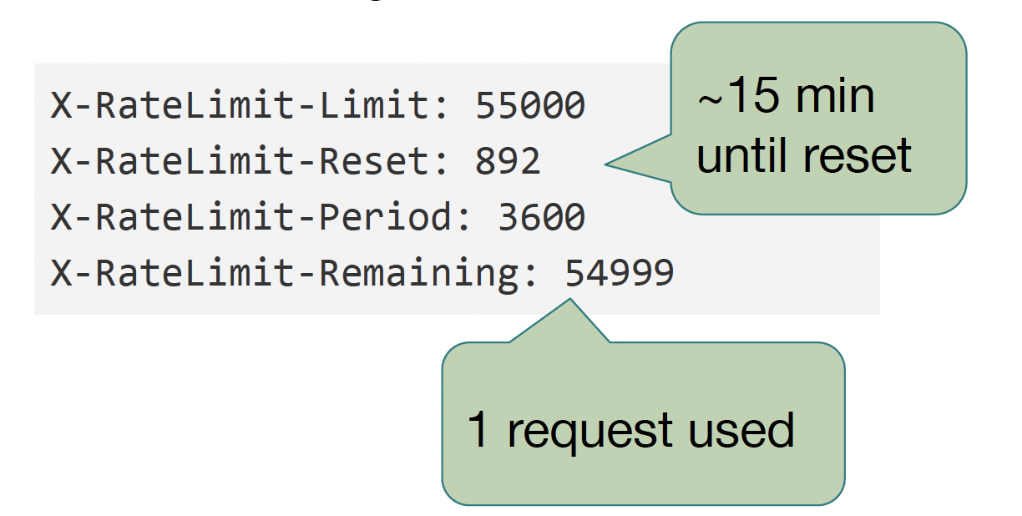
Rate limiting
Requests are rate limited to prevent a single user from monopolising the resources
Limits are per IP address
Your are allowed 55,000 requests over an hour (3,600 seconds – an average of 15 requests per second)
Notes:
In REST, the resource typically refers to some object or set of objects that are exposed at an API endpoint.

Slide 49
Want more? Full REST API training course
On-demand training – Learn online in your own time
https://www.ebi.ac.uk/training/online/courses/
ensembl-rest-api/
Live courses: Work with a trainer (virtually or in-person)
Trainers from the Ensembl Project can teach at any institute for free (plus trainers’ expenses in high-income countries)
Email: helpdesk@ensembl.org
training.ensembl.org/hosting
Notes:
In REST, the resource typically refers to some object or set of objects that are exposed at an API endpoint.

Slide 50
Getting help
Ensembl outreach team: helpdesk@ensembl.org
Developer mailing list: dev@ensembl.org
The REST API release notes:
https://github.com/Ensembl/ensembl-rest/wiki/Change-log
Notes:
In REST, the resource typically refers to some object or set of objects that are exposed at an API endpoint.

Slide 51
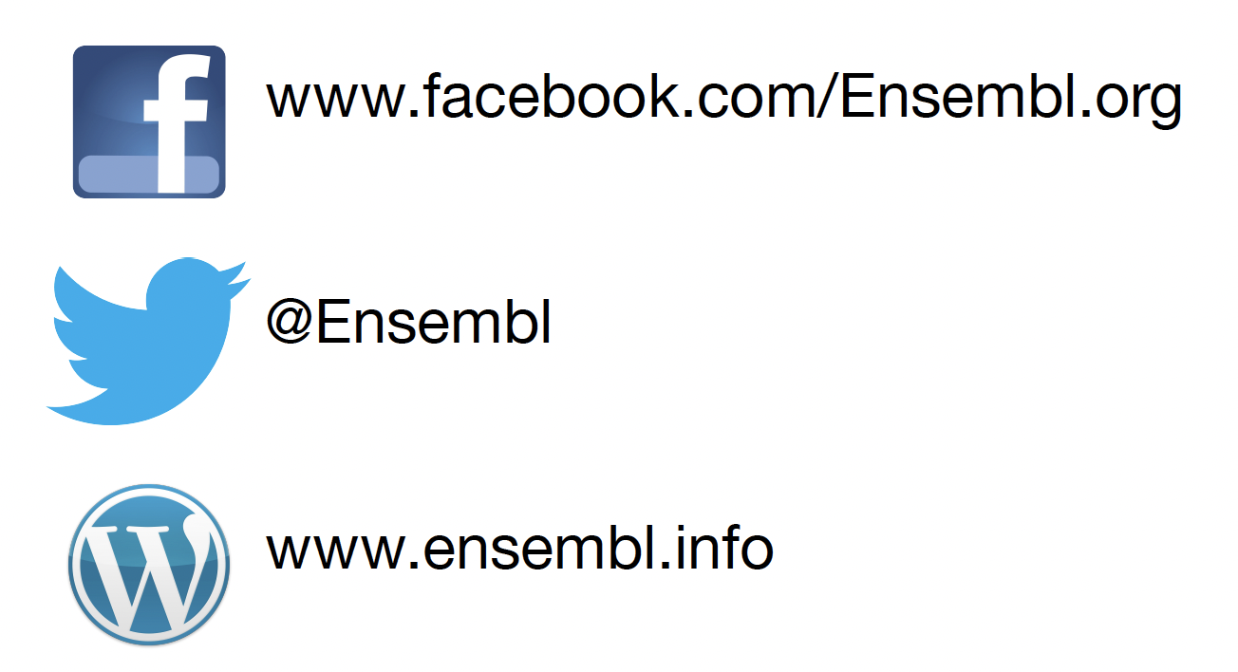
Follow Ensembl
Notes:
In REST, the resource typically refers to some object or set of objects that are exposed at an API endpoint.

Slide 52

Funders
Notes:
In REST, the resource typically refers to some object or set of objects that are exposed at an API endpoint.

Slide 53
Training materials
Ensembl training materials are protected by a CC BY license
If you wish to re-use these materials, please credit Ensembl for their creation
If you use Ensembl for your work, please cite their papers:
http://www.ensembl.org/info/about/publications.html
Notes:
In REST, the resource typically refers to some object or set of objects that are exposed at an API endpoint.

Slide 54
Training materials
These slides were mostly created by the Ensembl team!
Ensembl training materials are protected by a CC BY license
If you wish to re-use these materials, please credit Ensembl for their creation
If you use Ensembl for your work, please cite their papers:
http://www.ensembl.org/info/about/publications.html
Notes:
In REST, the resource typically refers to some object or set of objects that are exposed at an API endpoint.

Slide 55
Training materials
Gavin and Stefano – thanks for joining this effort!
Ensembl team
SMBE organisers – thanks for the space
You guys – thanks for your attention!
Notes:
In REST, the resource typically refers to some object or set of objects that are exposed at an API endpoint.

Slide 56
Time for exercises!
go to
Python: https://shorturl.at/SsPDw
Or R: https://shorturl.at/zR6I2
Click on File > Save a copy in Drive
Start the exercises in your copy!
Notes:
In REST, the resource typically refers to some object or set of objects that are exposed at an API endpoint.

